Slide 1
Using R and RStudio
© McGraw Hill LLC. All rights reserved. No reproduction or distribution without the prior written consent of McGraw Hill LLC.

Slide 2


What is R?
https://www.r-project.org/
R is a free software environment for statistical computing and graphics. It compiles and runs on a wide variety of UNIX platforms, Windows and MacOS. The R Foundation is a not for profit organization working in the public interest. It has been founded by the members of the R Development Core Team.

Slide 3
What is R Studio?
https://rstudio.com/products/rstudio/
RStudio is an integrated development environment (IDE) for R. It includes a console, an editor that supports direct code execution, and tools for plotting, history, debugging and workspace management. RStudio is available in open source and commercial editions. Students would likely choose Rstudio Desktop for Windows, Mac, or Linux.

Slide 4

What Does R Offer?
A versatile programming language
An integrated suite of software for
data manipulation
calculation
graphical display
data handling and storage
A large collection of procedures that are
well-documented
reviewed and improved
The R logo is © 2016 The R Foundation.

Slide 5

Installing R
Step 1: Visit the R project website.
https://www.r-project.org/
Step 2: Choose a CRAN mirror site near you.
https://cran.r-project.org/mirrors.html
Step 3: Download the version of R for your system
(Linux, (Mac) OS X, or Windows).
Step 4: Select install R for the first time
Step 5: Follow the setup instructions to install.
Look for the .EXE file in your Downloads (Windows) or .PKG file (Mac).

Slide 6

Installing RStudio
Step 1: Install R (see previous slide).
Step 2: Visit the Rstudio website.
https://rstudio.com/products/rstudio/
Step 3: Choose Rstudio Desktop Free.
Step 4: Click Download R Studio Desktop for your
system (Linux, (Mac) OS X, or Windows).
Step 5: Select Run or Open and follow the
instructions to install.
Look for the .EXE file in your Downloads (Windows) or .PKG file (Mac).

Slide 7
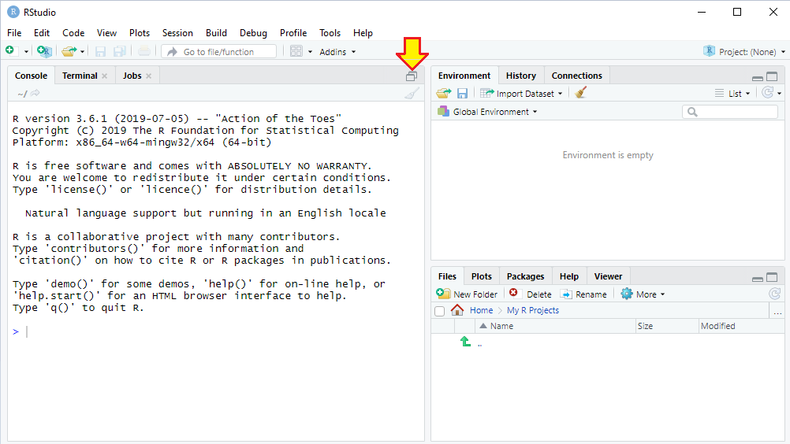
RStudio Interface
When you first run RStudio, you will see three panes:
To expand to 4 panes.
Environment pane keeps track of objects that you create.
Console pane lets you type R code and execute it later.
Task pane tabs (Files, Plots) show files and graphs you have created. Packages tab shows available R procedures. Help tab for any R topic.

Slide 8
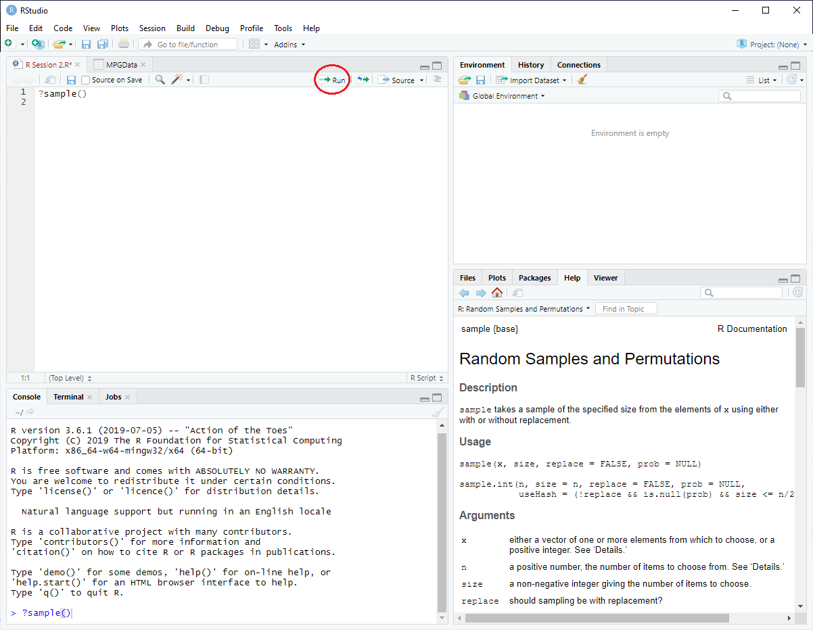

Four Screen View
Enter R code and execute it by pressing Run.
Function help is in this pane.
Executed code is shown in this pane.
Hint: If you don’t know a function's name, make a guess. As you type, R will offer choices.
?sample() to get help on the R function sample().

Slide 9
Vectors and Functions
R data is stored in vectors. A vector is an array of data values, like a row or column of data in Excel. A simple way to assign data to a vector is the R function c(). After the > prompt, enter your data values inside the parentheses, separated by commas. For example, to create a vector named x:
> x = c(5,6,7) # create a vector with three data values
Equivalently, you could have typed:
> x <- c(5,6,7) # create a vector with three data values
You can use either = or <- to assign values to a vector (your choice). Text following the # symbol is ignored, so you can annotate your code if you wish (it is often helpful).

Slide 10
Vectors and Functions
To display your data, type the name of the vector:
> x
[1] 5 6 7
Each line in your R output is preceded by a number in square brackets, which is an index like a line number. Because all three values fit on one line of output, we see [1] in this example. R creates additional lines of output if necessary,
You can use statistical functions on your vector. For example,
> sum(x) #calculate the sum of our data values
[1] 18
> mean(x) #calculate an average of our data values
[1] 6

Slide 11
Manipulating Data
We can do other useful things to data. For example, we can stack vectors into a single vector, or put them into a data frame:
> x1=c(4,5,6) # create a vector containing 4,5,6
> x1
[1] 4 5 6
> x2=c(7,8,9) # create a vector containing 7,8,9
> x2
[1] 7 8 9
> x3=c(x1,x2) # stack the two vectors into one column
> x3
[1] 4 5 6 7 8 9
> xdata=data.frame(x1,x2) # put both vectors columns into a data frame
> xdata
x1 x2
1 4 7
2 5 8
3 6 9

Slide 12
Vectors and Functions
You can name a vector using any combination of letters, digits, period (.) and underscore (_). It must start with a letter or a period. If it starts with a period, it cannot be followed by a digit. Reserved words in R cannot be used as identifiers. Case is important (hence BodyStyle is not the same object as bodystyle). A vector can contain attribute data (non-numeric) by enclosing each data value in quotation marks. For example:
> BodyStyle = c("Sedan", "SUV", "Truck", "Other")
> BodyStyle
[1] "Sedan" "SUV" "Truck" "Other"
> bodystyle
Error: object 'bodystyle' not found
Hint: R may not recognize an object if you are careless about uppercase and lowercase (deliberately shown here to illustrate the point).

Slide 13

Vectors and Functions
You can create vectors in other ways, using functions or rules. For example, to make a vector MyIntegers containing integers 1 to 10:
> MyIntegers = c(1:10)
> MyIntegers
[1] 1 2 3 4 5 6 7 8 9 10
> mean(MyIntegers)
[1] 5.5
Another way to create data is using a function. For example, we can use the R function sample() to create a vector (we called it MySample) containing a random sample of 5 integers in the range 0 to 1000 :
> MySample = sample(0:1000,5)
> MySample
[1] 521 989 766 300 922
Tip: Some function arguments can be omitted if you are willing to accept the default values. This example used is a “stripped-down” version of sample() for clarity.

Slide 14
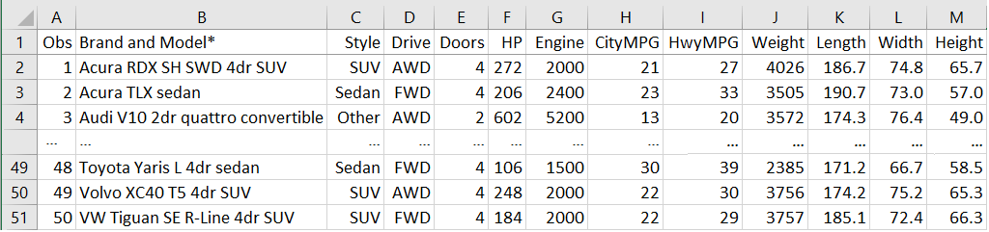
Spreadsheet Data
Suppose we have an Excel spreadsheet (50 rows, 13 columns) with data for a sample of 2020 vehicles (abbreviated here). We want to import some (or all) of the data into a data frame in R.
A data frame is similar to a matrix except that its columns can have names. That is appropriate because each of our columns already has a heading. How can we get this data into R?

Slide 15
Clipboard Import
An easy way to import data to R is the clipboard. Highlight the data block in Excel (including column headings) and copy it to the clipboard using Ctrl+c (Windows) or command+c (MacOS). Now enter (for Windows):
> MPGData = read.table(file="clipboard", sep="\t", header=TRUE)
For MacOS you would enter
> MPGData = read.table(pipe("pbpaste", sep="\t", header=TRUE)
The argument sep="\t" tells R that the columns are tab-separated. The argument header=TRUE tells R to expect text headings on each column.
Tip1: R doe not like column names that begin with a number or contain special symbols like % and $.
Tip2: An advantage of the clipboard method is that you choose exactly what to import.

Slide 16
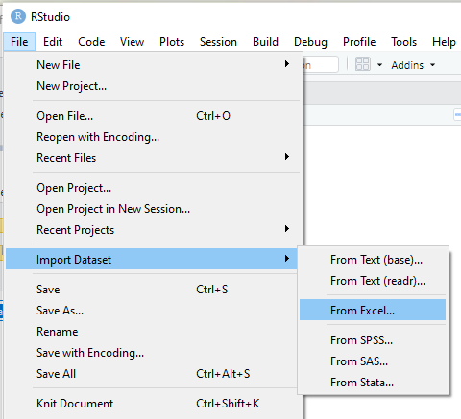
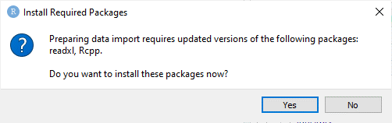
Excel Import
To import an entire Excel spreadsheet, choose File > Import Dataset > From Excel in the upper left corner of the Scripts pane:
Note: Depending on your R version, you may be asked to download an update:

Slide 17
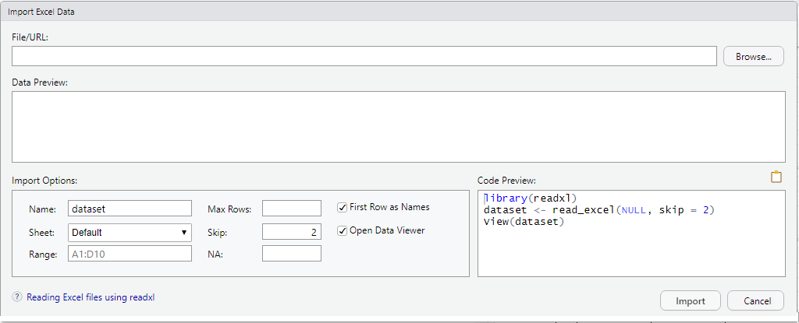
Excel Import
When prompted, click the Browse button to locate the Excel file and then click the Import button. There are options. You can select the Excel data Range. You can Skip the first few lines in the Excel file (in case the data does not start on line 1).
Tip: Many spreadsheets have a descriptive title above the data array.

Slide 18
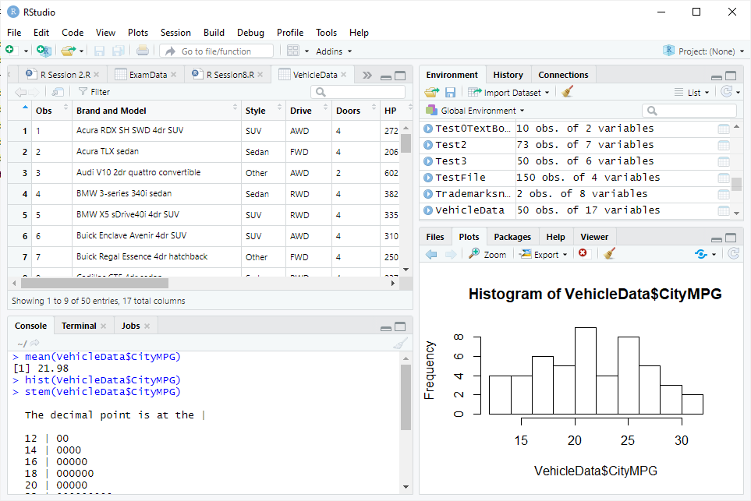
Excel Import
Our file was called VehicleData.xlsx. After importing the file, we see a tab VehicleData in the Scripts window and a view of the data. The new R data frame is named VehicleData (or whatever your file was called).
Now you can calculate statistics or make graphs.
https://support.rstudio.com/hc/en-us/articles/218611977-Importing-Data-with-RStudio

Slide 19
Data Analysis
Once the data are imported to data frame VehicleData we can view the data, calculate statistics, and so on. For example, to calculate average city miles per gallon (the variable CityMPG in the data frame) we use the R function mean() and name the variable in the data frame followed by $ (the dollar symbol) as follows:
> mean(VehicleData$CityMPG)
[1] 21.98
We can get additional statistics using the summary() function.
> summary(VehicleData$CityMPG)
Min. 1st Qu. Median Mean 3rd Qu. Max.
13.00 18.00 22.00 21.98 26.00 31.00
Tip: Don't forget the $ symbol before the variable name.

Slide 20
Data Analysis
If our data frame columns have names (as they do here) we can get summary statistics for more than one variable using the summary() function. For example:
> summary(MPGData[c("Weight","Length")])
Weight Length
Min. :2385 Min. :151.1
1st Qu.:3356 1st Qu.:181.9
Median :3662 Median :192.2
Mean :3954 Mean :190.9
3rd Qu.:4661 3rd Qu.:198.7
Max. :5917 Max. :231.9
Tip: Be careful of syntax, e.g., the square brackets [ ] and quotation marks around variable names.

Slide 21

Data Analysis
You can also refer to columns in your data frame by number. You can use a colon : if your columns are contiguous (e.g., 6 through 8):
> summary(VehicleData[c(6:8)])
HP Engine CityMPG
Min. :106.0 Min. :1400 Min. :13.00
1st Qu.:182.5 1st Qu.:2000 1st Qu.:18.00
Median :249.0 Median :2500 Median :22.00
Mean :262.3 Mean :2898 Mean :21.98
3rd Qu.:308.0 3rd Qu.:3500 3rd Qu.:26.00
Max. :602.0 Max. :6200 Max. :31.00
Tip: The c() function allows you to select more than one variable. Be careful of syntax, e.g., the $ symbol and square brackets [ ].

Slide 22
Descriptive Statistics
If columns are not contiguous (e.g., 6, 8, 11) use commas as separators:
> summary(VehicleData[c(6,8,11)])
HP CityMPG Length
Min. :106.0 Min. :13.00 Min. :151.1
1st Qu.:182.5 1st Qu.:18.00 1st Qu.:181.9
Median :249.0 Median :22.00 Median :192.2
Mean :262.3 Mean :21.98 Mean :190.9
3rd Qu.:308.0 3rd Qu.:26.00 3rd Qu.:198.7
Max. :602.0 Max. :31.00 Max. :231.9
Tip: The c() function allows you to select more than one variable. Be careful of syntax, e.g., the $ symbol and square brackets [ ].
Tip: If you are having trouble keeping track of your variables, the Console pane in the upper left of RStudio has tabs for each data frame. Click on VehicleData and you will see a list of the data.

Slide 23

Saving Your Work
To save a script that you have developed, click File > Save As in the Script pane to name a folder for your own files (e.g., MyRScripts). Instructors may suggest downloading specific CRAN packages to make R tasks a bit easier. To see what packages you already have, click the Packages tab in lower right pane, or search the CRAN website. Specific R topics are illustrated in chapters in this textbook. See Appendix J
for a side-by-side comparison or Excel and R functions.
> rm() # to remove a variable in R
> ls() # to see all the variables you have created
> Ctrl-L # to clear the Console (in Windows)
> Option-L # to clear the Console (in MaxOS)
Bonus: A few useful R functions or commands:

Slide 24
Online Resources
The Internet offers many videos and documents to help you learn R. How to decide which is best for your specific need? You might want to check out R-Bloggers.com. This site helps R bloggers and users connect. It lists various channels by topic, and tells whether authors provided slides, code, or additional materials.
R Bloggers
https://www.r-bloggers.com/learning-statistics-on-youtube/

Slide 25
Online Tutorials
These are only a few examples. Try your own search!
Mike Marin Statistics and R Programming
https://www.youtube.com/user/marinstatlectures/playlist
Econometrics Academy (includes advanced topics)
https://www.youtube.com/user/econometricsacademy/playlists/
Codecademy
https://www.codecademy.com/
Jalayer Academy
https://www.youtube.com/channel/UCTprjveyeUA-pn6b7KbGhmQ

Slide 26
Better things are coming … THIS PRESENTATION IS ALWAYS EVOLVING
Disclaimer The web links listed here are not intended as endorsements, but rather as sources of information. The web evolves continually, so any list is quickly outdated. The web links change with annoying frequency! But these suggestions provide a place to start.

